Slide 1
Energy Methods
Energy methods for multiple forces at multiple points

Slide 2
Influence coefficients
We are used to relating forces and the deflections produced because of deformation caused by such forces through stiffness or stiffness coefficients
That is
F

Slide 3
Influence coefficients
For a two dimensional body we can have number of such stiffnesses relating the force components to the deflection components
That is
The relations are expressed in a compact form through a matrix equation

Slide 4
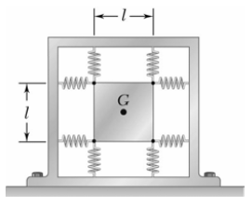
Influence coefficients
If we look at the figure shown, we can see that the point G can move in both x and y directions and a force acting on G will in general have both x and y components
For such problems the relations between force and displacement will have the form described.
F_{y}
F
F_{x}

Slide 5
Influence coefficients
If we invert this relation we will get
The inverted matrix can be thought of as a compliance matrix with the components being compliance coefficients

Slide 6
Influence coefficients
If we simplify the matrix relations we will get the following equations
But this again is the relation between the displacement of a single point and forces at that point.
The inverted matrix can be thought of as a compliance matrix with the components being compliance coefficients

Slide 7
Influence coefficients
Influence coefficients extend this idea a little further.
Multiple forces and multiple points are considered.
Each force contributes a little to the deflection of a point and this contribution is related to the force through an influence coefficient
The net deflection of a point is the sum total of these contributions.
The inverted matrix can be thought of as a compliance matrix with the components being compliance coefficients

Slide 8
Reciprocal relation
We consider a body as shown being constrained at certain points and with two forces acting at points 1 and 3 and the deflection being considered for point 2
Point 2 moves in a direction D₂ with d₂ being the component in a given direction with D₂. In this case the direction is vertically downwards.
F₁
1
F₃
3
2
θ
d₂
D₂

Slide 9
Reciprocal relation
We apply a force at 1 and consider the deflection at 1
If the material obeys Hooke’s law, that is relationships are linear, then the deflection at 1 will be
k₁ is a proportionality constant
The direction of D₁ will be , in absence of other forces, in the direction of F₁.
F₁
1
3
2

Slide 10
Reciprocal relation
Things get a little more complicated when we apply a force at 1 and observe a deflection at 2
If the material obeys Hooke’s law, that is relationships are linear, then the deflection at 2 will be
k₂₁ is a proportionality constant
The direction of D₂ need not be the same as that of F₁.
F₁
1
3
2
θ
d₂
D₂

Slide 11
Reciprocal relation
If we are interested in the deflection in a particular direction which we name as θ, and call this deflection d_{2θ}, then
a₂₁ is called the influence coefficient for the displacement of 2 in the given direction θ due to a force at 1.
F₁
1
3
2
θ
d₂
D₂

Slide 12
Reciprocal relation
We can now consider a force F₃ applied at 3 and the consequent deflection of point 2 in the given direction θ. In this case we will get
a₂₃ is the influence coefficient for the displacement of 2 in the given direction θ due to a force at 3.
1
F₃
3
2
θ
d₂
D₂

Slide 13
Reciprocal relation
Since the relations are linear, we can apply superposition when both the forces act and get
If there are more forces at more points more terms will be added.
F₁
1
F₃
3
2
θ
d₂
D₂

Slide 14
Reciprocal relation
Let us now consider the deflection of 2 in the direction of 1
Likewise consider the deflection of 3 in the direction of 1
For each case there will be a new set of influence coefficients
F₁
1
F₃
3
2
θ
d₂
D₂

Slide 15
Reciprocal relation
We now consider that there is a force at 2 as well
We get for deflection of point 2 in the direction of the force at 2 as
F₁
1
F₃
3
2
D₂
F₂

Slide 16
Reciprocal relation
We can similarly write for point 1 and 3
F₁
1
F₃
3
2
θ
d₂
D₂

Slide 17
Reciprocal relation
We now define a displacement called corresponding or work absorbing displacement δ₂ which stands for the sum of all components of displacement at point 2 in the direction of the force at 2, caused by the forces at all loaded points.
This is the same as d₂₂ .But for the sake of brevity we can remove the repeating 2 in the indexes and write
We can similarly write for say the deflection of point 1 in the direction of the force as 1 as

Slide 18
Reciprocal relation
Hence if we have n such forces we may write for the deflection of the ith point in the direction of the ith force as
This component is responsible for the work done by the ith force.

Slide 19
Reciprocal relation
Now consider the work done by F_{i} due to all the displacements in our original example
Only those components of the displacement in the direction of F_{i} will matter (hence the term work absorbing)
Hence

Slide 20
Reciprocal relation
We now consider a body subjected to two forces at two different points.
First only F₁ is applied quasistatically, followed by F₂ applied quasistatically.
For the initial part since F₂ is absent, displacement at 1 in the direction of F₁ is only
Hence work done by the slowly increasing F₁ is

Slide 21
Reciprocal relation
When F₂ is then applied quasistatically with F₁ already having reached its final value, the final displacement at 1 in the direction of F₁ is
The additional displacement taking place at 1 after F₂ becomes active is
During this time F₁ is constant. Hence final additional work done by F₁ is

Slide 22
Reciprocal relation
When F₂ is also applied quasistatically with F₁ having reached its final value, there is also displacement in the direction of F₂.
This is the displacement due to F₂ only. The earlier displacement in the direction of F₃ due to F₁ plays no role as F₂ was absent in that period). Hence this is
Since F₂ increases quasistatically the work done is

Slide 23
Reciprocal relation
Total work done is

Slide 24
Reciprocal relation
If we reverse the procedure, that is we first have only F₂ increasing quasistatically to its final value followed by F₁ increasing quasistatically to its final value, the work done will similarly be

Slide 25
Reciprocal relation
Since the final stored internal energy for both processes must be the same

Slide 26
Reciprocal relation
In general
Also internal energy

Slide 27
Reciprocal Theorem
Now consider a system of n forces P₁, P₂ …, P_{n} acting at points 1,2, … , n causing displacements at those points having components δ₁, δ₂ …, δ_{n} in the direction of the forces.
P₁
1
P_{n}
n
2
P₂

Slide 28
Reciprocal Theorem
Also consider another system of n forces Q₁, Q₂ …, Q_{n} acting at the same points 1,2, … , n in the same directions (but not necessarily having same magnitudes) and causing displacements at those points that have components γ₁, γ₂ …, γ_{n} in the direction of the forces.
Q₁
1
Q_{n}
3
2
Q₂

Slide 29
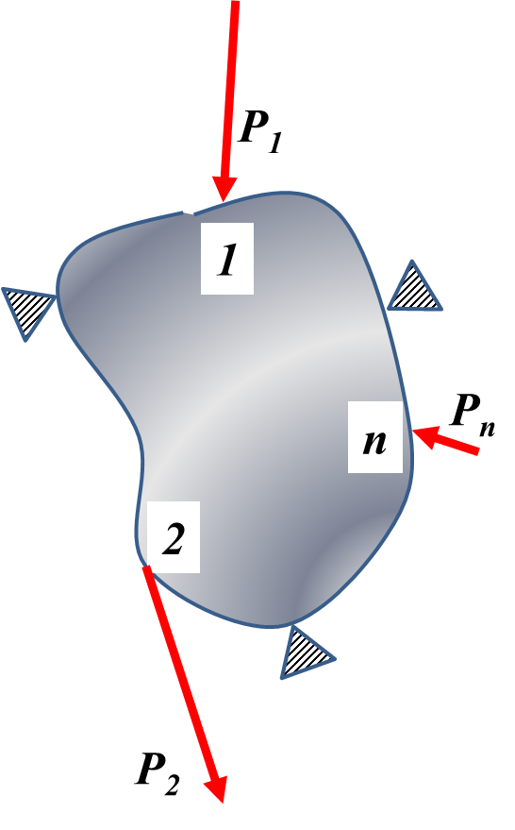
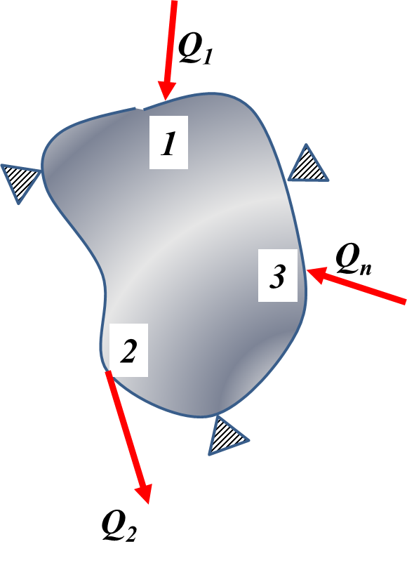
Reciprocal Theorem
We wish to see what will be the relationship between the forces of one system and the displacements of the other.

Slide 30
Reciprocal Theorem
Consider the following expression involving forces of system 1 and displacements of 2.
Each displacement can be written using influence coefficients for system 2 as

Slide 31
Reciprocal Theorem
We therefore get

Slide 32
Reciprocal Theorem
Expand

Slide 33
Reciprocal Theorem
Rearrange

Slide 34
Reciprocal Theorem
Use reciprocal relations for influence coefficients.

Slide 35
Reciprocal Theorem
Now consider the following expression involving forces of system 2 and displacements of 1
Since each Q_{i} has the same direction as each P_{i} and acts at the same point i, hence the same influence coefficients can be used to evaluate the displacements for system 1 as well.
Hence

Slide 36
Reciprocal Theorem
We get after similar manipulations

Slide 37
Reciprocal Theorem
The forces of the first system (P₁, P₂, . . . P_{n}) acting through the corresponding displacements produced by any second system (Q₁, Q₂, . . . Q_{n}) do the same amount of work as that done by the second system of forces acting through the corresponding displacements produced by the first system of forces
This is the Reciprocal theorem of Maxwell, Betti and Rayleigh.

Slide 38
Castigliano’s Method
Strain energy of a linear system

Slide 39
Castigliano’s Method
We take the partial derivative with respect to any one force F_{k} and apply product rule within the summations

Slide 40
Castigliano’s Method
We first break up the sum into two

Slide 41
Castigliano’s Method
Then we interchange the order of summation in the second term

Slide 42
Castigliano’s Method
Simplify each summation further

Slide 43
Castigliano’s Method
All derivatives will be zero except when i=k or j=k. Hence

Slide 44
Castigliano’s Method
Hence
Recall the expression for deflection at point k in the direction of F_{k}
Hence

Slide 45
Castigliano’s Method
Now consider a linear spring with stiffness k
Its strain energy in terms of applied force P is
Applying this method
The method works

Slide 46
Castigliano’s Method
Now consider a nonlinear spring where the force vs displacement relation is
Its strain energy in terms of applied force P is

Slide 47
Castigliano’s Method
Applying Castigliano’s Method
Wrong displacement is obtained

Slide 48
Castigliano’s Method
Consider a nonlinear spring where the force vs displacement relation is
Define a term complimentary strain energy

Slide 49
Castigliano’s Method
Applying Castigliano’s Method to the complimentary energy
Correct displacement is obtained

Slide 50
Theorem of virtual work
Consider a system in equilibrium under the action of n forces acting at n points with all the points having undergone the required displacements.
Let there be a small incremental displacement at the ith point, in the direction of the ith force, such that all the forces at the other points remain unaffected. Since this is actually not possible we call this a virtual displacement.
The only way this can be possible is if the ith force readjusts itself. This can involve a change in magnitude as well as direction.

Slide 51
Theorem of virtual work
Thus a small displacement Δδ_{i} at the ith point results in a change of F_{i} to F_{i}+ ΔF_{i}.
Work done by F_{i} is F_{i}Δδ_{i}
Work done by ΔF_{i} is kΔF_{i}Δδ_{i}
Here k is fraction since unlike F_{i} , ΔF_{i} need not be in the direction of Δδ_{i}
Hence net virtual work done because of this virtual displacement is

Slide 52
Theorem of virtual work
The virtual work done will be stored as virtual internal energy
As the virtual displacement Δδ_{i} tends to zero

